Slide 1
HOUSE PRICE PREDICTION MODEL
-By vidhi Agarwal
Iit delhi

Slide 2
APPROACH
Exploratory Data Analysis (EDA)
Data Examination: Identified and handled missing values and outliers.
Visualization: Used scatter plots and bar graphs to explore relationships and key features.
Data Preprocessing
Label Encoding: Converted categorical variables to numerical format.
Normalization: Scaled features for improved model performance.
Model Development
Linear Regression
Trained to predict house prices.
Evaluated using Mean Squared Error (MSE) ,Mean Absolute Error (MAE) and R-squared.

Slide 3
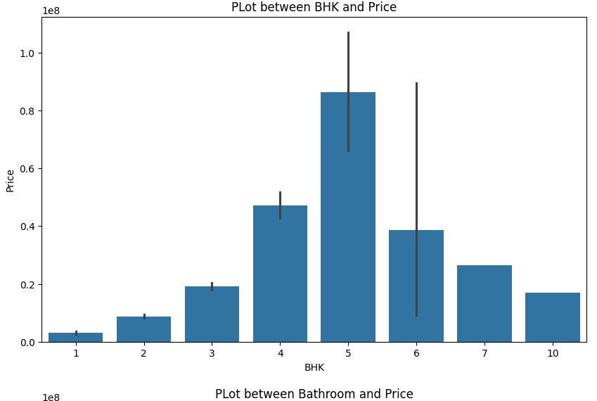
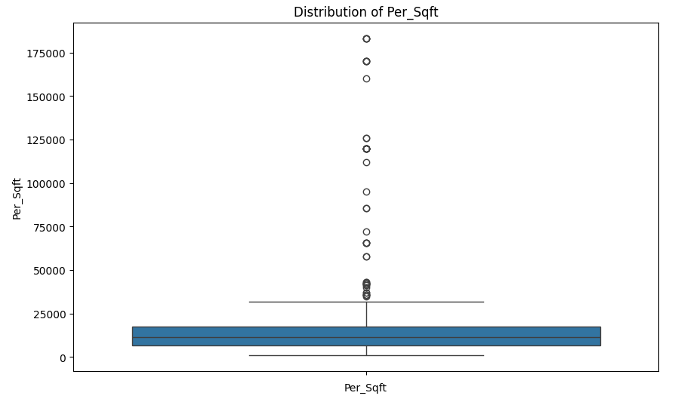
Exploratory Data Analysis(EDA)
Handling Missing Values
Identified and imputed missing values to ensure data completeness and integrity.
Data Visualization
Bar Graphs:
Analyzed relationship between house prices and various parameters like BHK, Furnishing, Parking, etc.
Provided insights into how these factors influence pricing.
Box Plots:
Examined distribution of Area and Price per Square Foot.
Identified outliers and variability in the data.
Bar Graph
Box Plot

Slide 4
Data Pre-processing
Label Encoding
Categorical Conversion: Transformed categorical variables (e.g., Locality, Furnishing, Status etc) into numerical values using label encoding.
Model Compatibility: Ensured that all features were in a format suitable for machine learning algorithms.
Data Scaling
Normalization: Used MinMaxScaler to scale the data features to a range of 0 to 1.
Why MinMaxScaler: Maintains the relationships between features and is less sensitive to outliers compared to standard scaling.
Improved Model Performance: Enhanced model performance and stability by ensuring that all features contributed proportionately to the learning process.

Slide 5
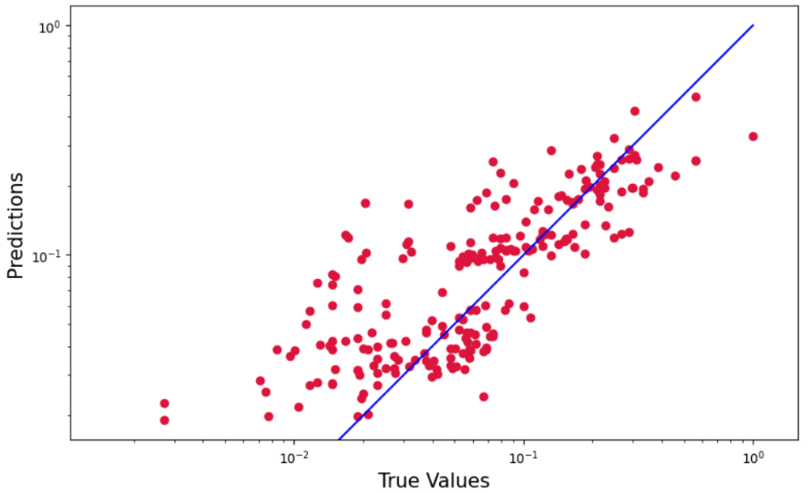
Model Development
Linear Regression Model
Model Building: Developed a Linear Regression model to predict house prices based on selected features.
Training: Trained the model on the preprocessed dataset to learn the relationships between features and house prices.
Model Evaluation
Mean Absolute Error (MAE): Calculated to measure the average absolute errors between predicted and actual prices.
Mean Squared Error (MSE): Computed to assess the average squared differences between predicted and actual prices, giving more weight to larger errors.
R-squared (R²) Score: Evaluated to determine the proportion of variance in house prices explained by the model, indicating the model's overall goodness-of-fit.
Predicted vs True value

Slide 6
Results
Model Performance Metrics
Mean Squared Error (MSE): 0.0054
Indicates the average of the squared differences between predicted and actual prices.
A lower MSE signifies better model accuracy and fewer large errors.
Mean Absolute Error (MAE): 0.0423
Represents the average absolute differences between predicted and actual prices.
A lower MAE indicates high accuracy and fewer prediction errors.
R-squared (R²) Score: 0.5934
Measures the proportion of variance in house prices explained by the model.
An R² score of 0.5934 suggests that approximately 59.34% of the variability in house prices is captured by the model, indicating a moderate fit.

Slide 7
Conclusion and References
Conclusion
Effective EDA: Thoroughly analyzed and visualized data, leading to valuable insights for feature selection and preprocessing.
Robust Preprocessing: Successfully handled missing values, applied label encoding, and scaled data using MinMaxScaler, ensuring data was well-prepared for modeling.
Model Development: Built a Linear Regression model, evaluating its performance with key metrics (MAE, MSE, R²).
Model Performance: Achieved an R² score of 0.5934, indicating a moderate fit, with low MSE and MAE values demonstrating reasonable accuracy.
Future Improvements: Exploring more complex models and additional features to enhance predictive accuracy and model fit.
References
https://www.geeksforgeeks.org/machine-learning/
https://www.kaggle.com/

